Slide 1
EXCEPTION HANDLING
Any unexpected event or unwanted event that disturbs the normal flow of your program is known as exception.
To maintain the normal flow of program we handle those exceptions using some pre-defined classes.
The process of handling an exception is known as exception handling.

Slide 2
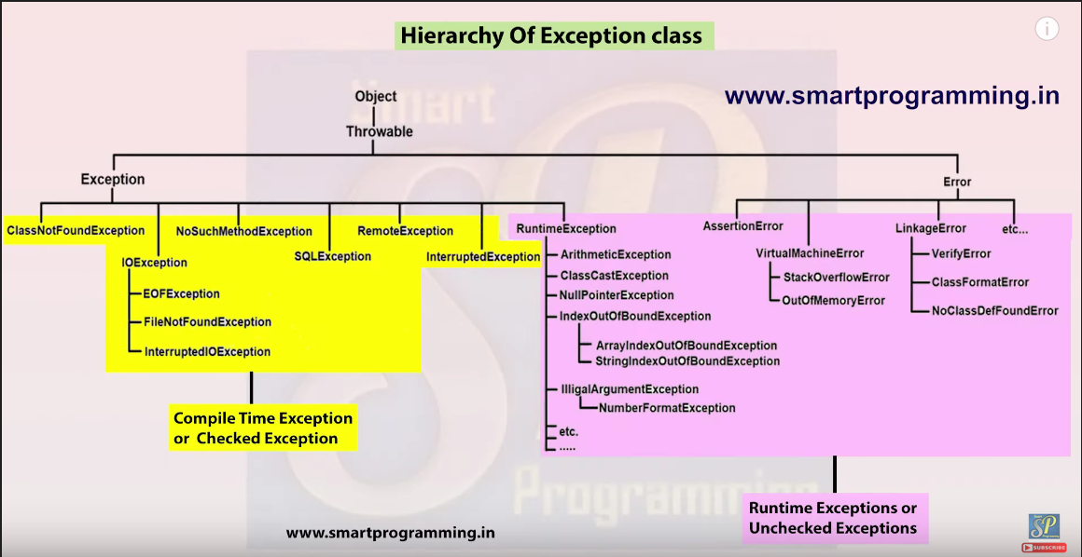

Slide 3
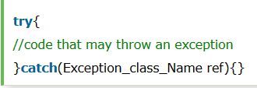

Slide 4
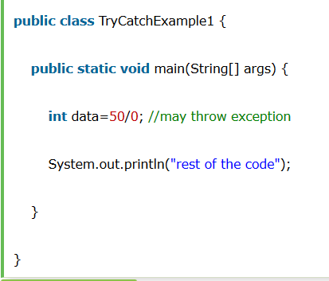

Slide 5
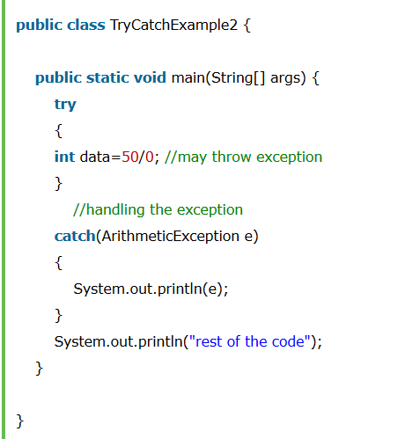

Slide 6
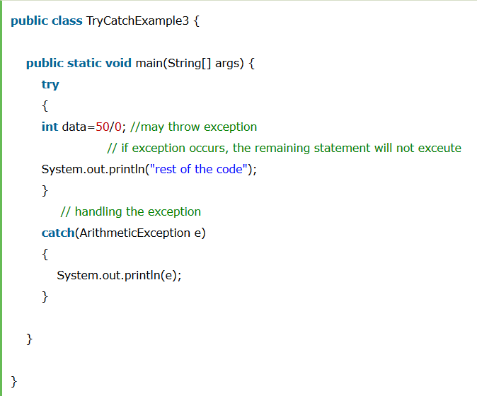

Slide 7
